Slide 1
Brownfields Qualified Environmental Professional Services
For the FY2022 U.S. EPA Brownfields Assessment Grant
City of Gardiner
September 21, 2022

Slide 2
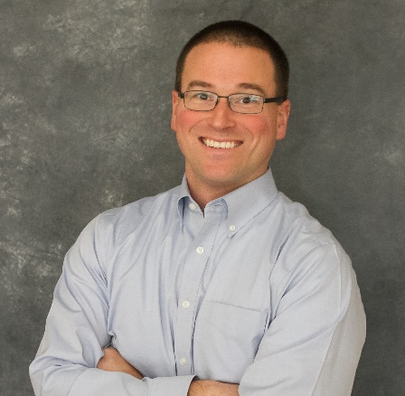

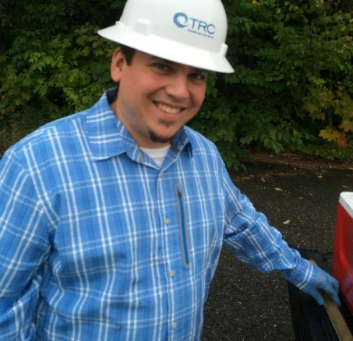


Your Dedicated Brownfields Team
Charlie Springer, LG, CHMM
Brownfields Program Manager
Joel Prellwitz, LG
Project Manager
Emily Wassmer, LG
Brownfields Advisor / Senior Geologist
Full Support Team of Engineers, Geologists, and Risk Assessors
With Deep Brownfields Experience
Notes:
Get new photo for Charlie?
Mention Diane Silverman, Kim Tiza (sp?), etc.

Slide 3

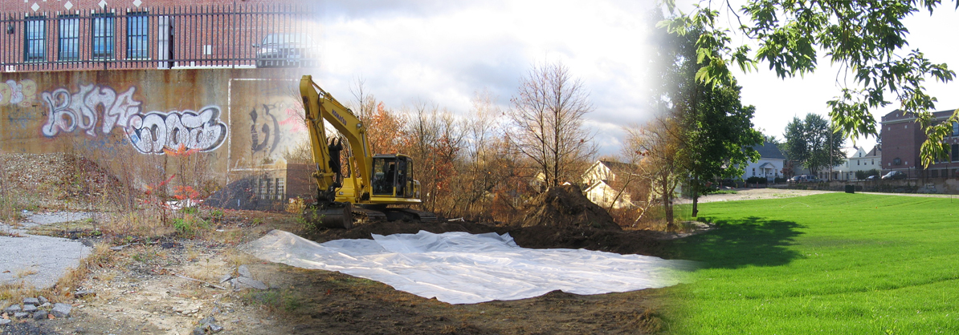
Community Focused
TRC will be Your Partner in:
Building a Sustainable Brownfields Program
Collaboration with Stakeholders
Coordination with City Departments
Engaging the Community
Bringing projects and owners/developers to the City

Slide 4
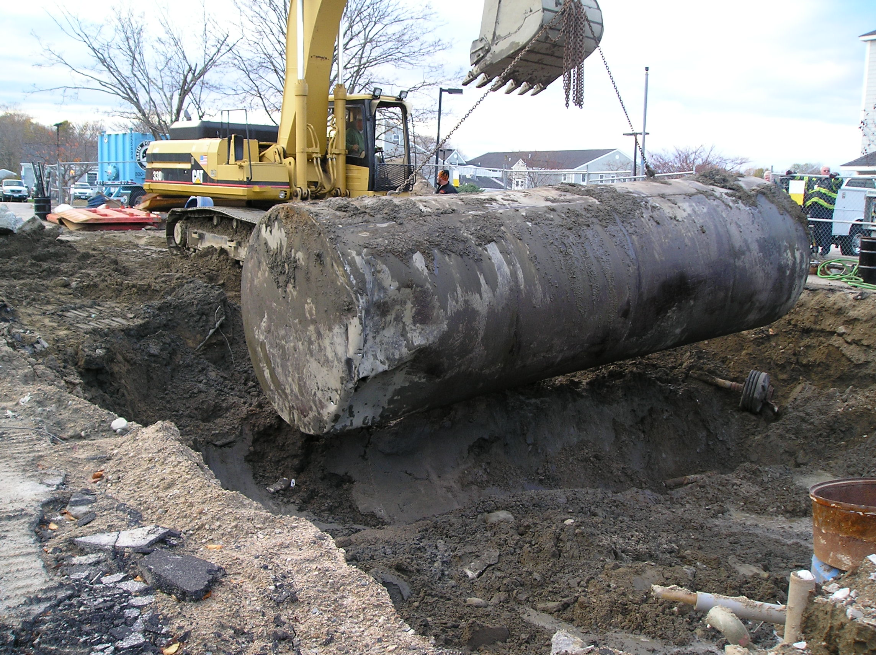
TRC Company Overview
TRC has created value-added solutions to environmental challenges since the 1970s
Unmatched EPA Brownfields Expertise
  Over 150 Successful EPA Brownfields Programs
  Over 500 EPA Brownfields Assessments/Cleanups
  Over 50+ Dedicated Brownfields Professionals
TRC – As a Company
TRC – In Maine
Supporting Multiple Brownfields Programs
Hundreds of Successful Assessments and Cleanups
Offices in Augusta, Bath, and Scarborough
Over 250 staff in Maine

Slide 5

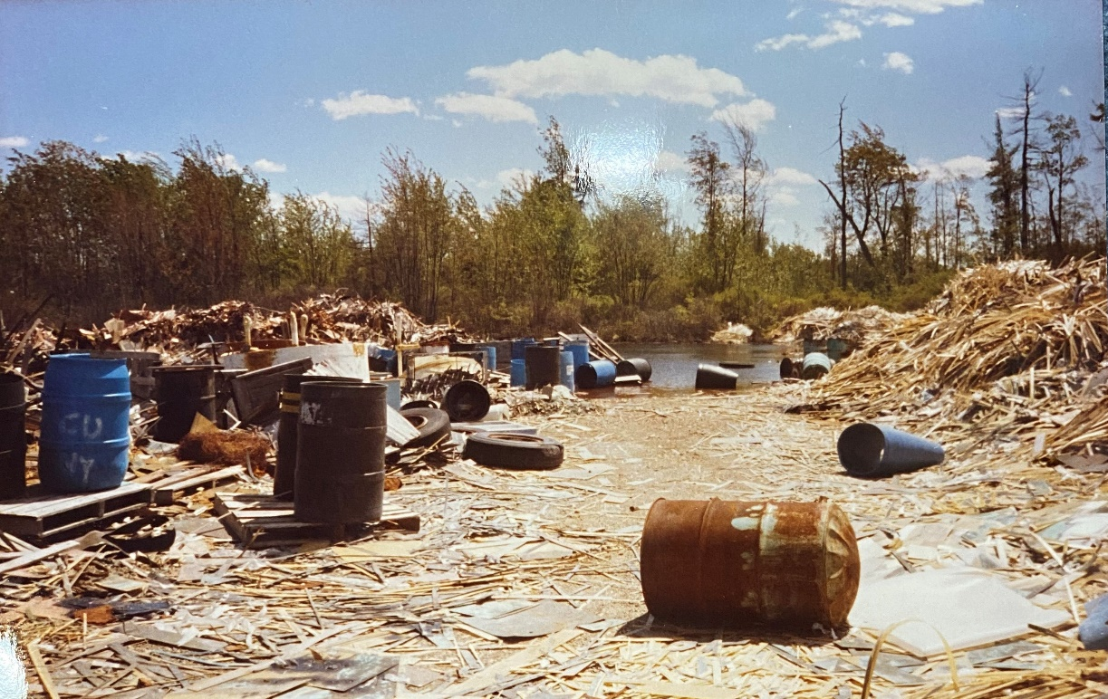
TRC’s
In-House Capabilities
Professional Engineers (PEs) and Licensed Geologists (LGs)
Premier in-house risk assessment and TSCA solution services
Relationships with EPA and the Maine DEP
Creative Brownfields cleanup/reuse solutions
Demonstrated track record of successful quality projects
Preparing CRPs, ABCAs, QAPPs, HASPs, & completion reports
Extensive community outreach

Slide 6
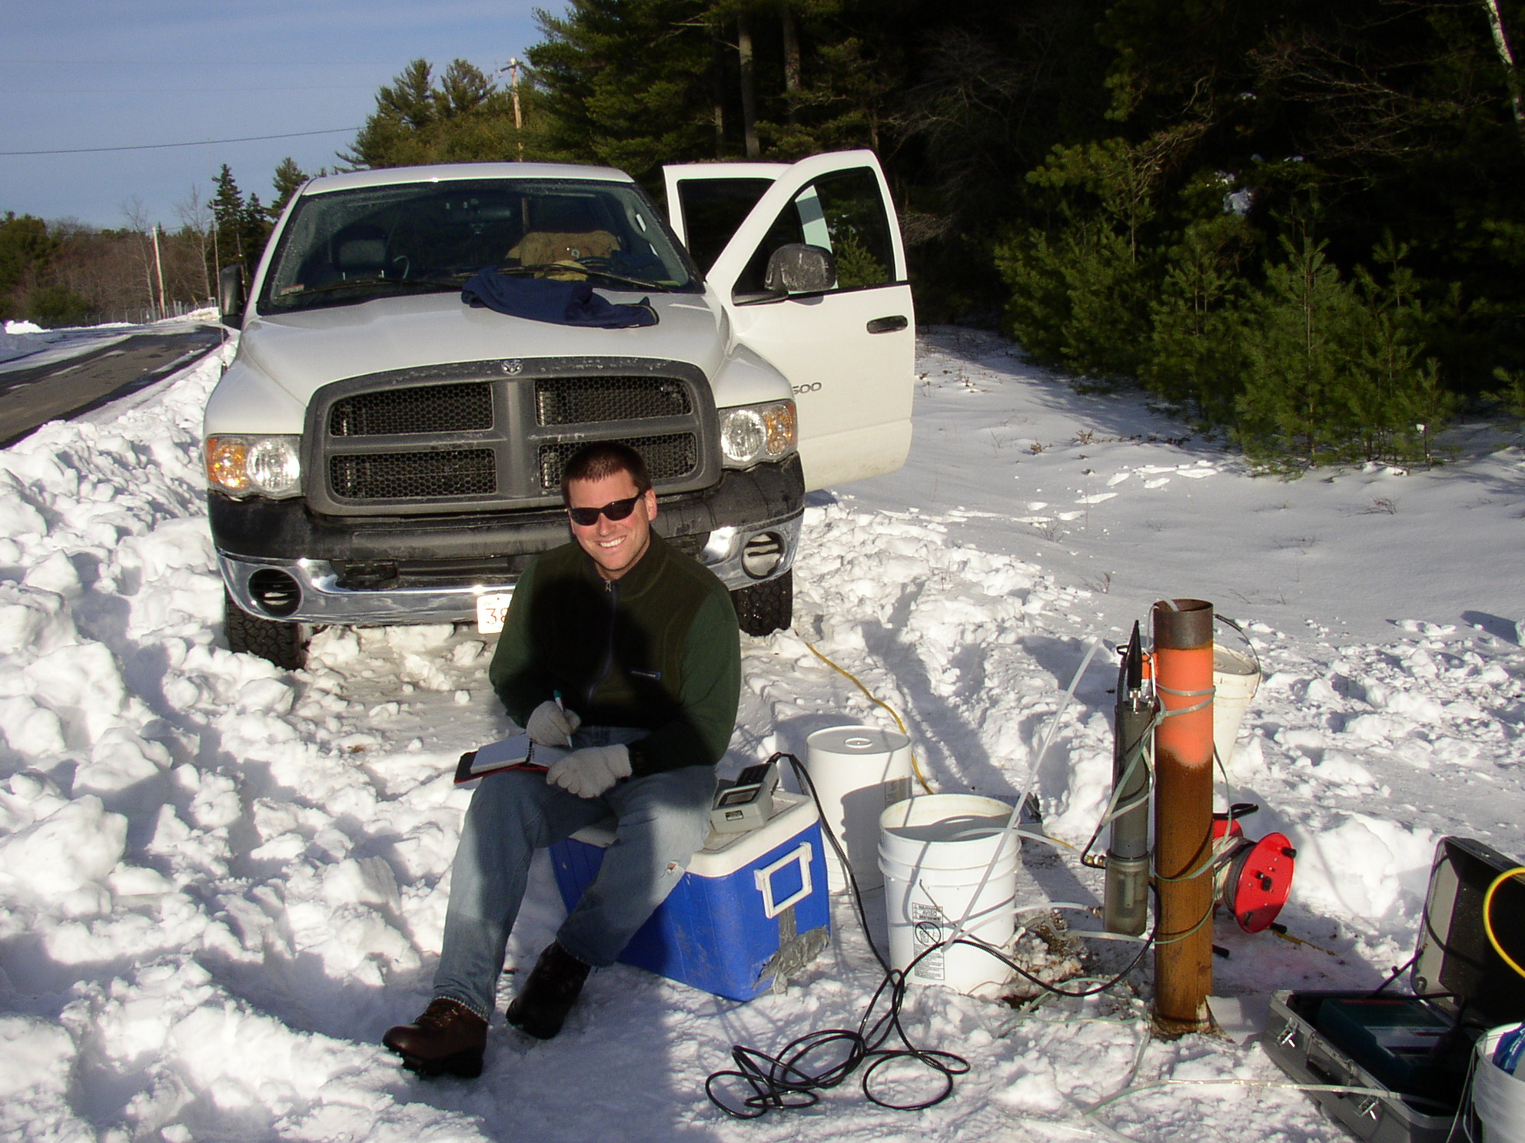
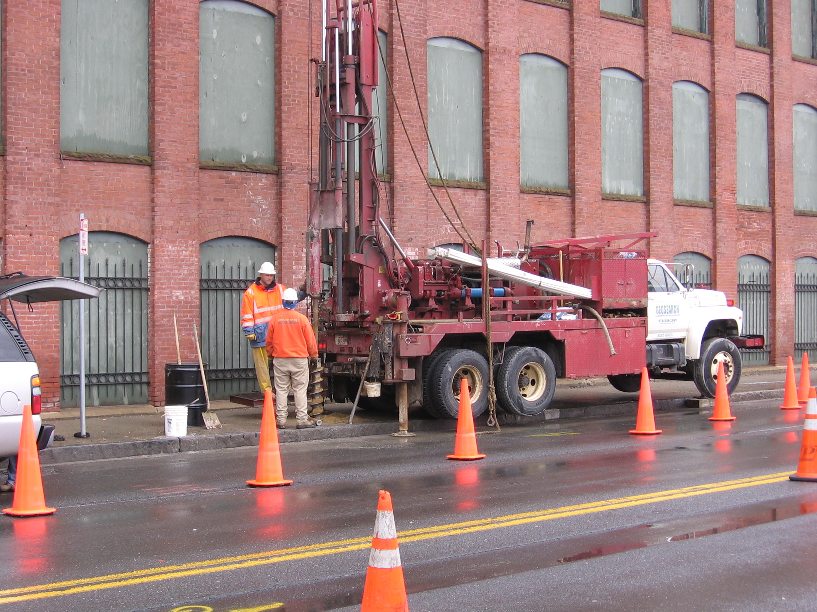
TRC’s Brownfields Experience
Unmatched EPA Brownfields Expertise
In-House Technical Experts for All Services
Local Partnership Approach
Recognized by EPA and DEP as Leaders
Millions of Dollars Leveraged in Cleanup and Redevelopment
Assessment
Cleanup
Revolving Loan Fund
Community Outreach
Notes:
Talk about the regions/municipalities that we’ve partnered with in the past for each type of grant.
Seems redundant with previous slide?

Slide 7
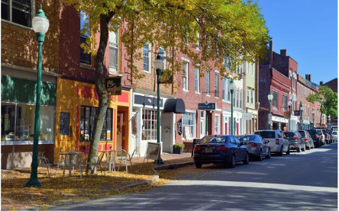
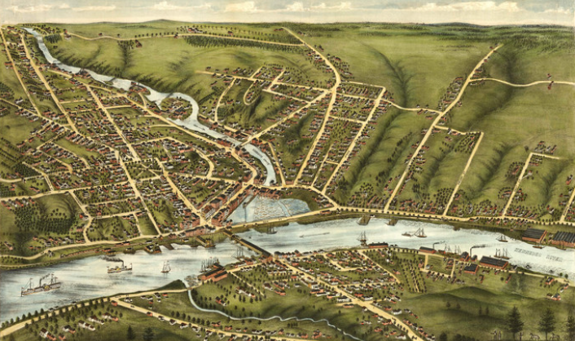

TRC and the City
Experience working with City staff
City Projects in partnership with KVCOG’s Brownfields program
Building renewable energy in the City
Developer Relationships
Familiarity with the area – Downtown Revitalization / River Corridors
Some of our Staff call Gardiner home!
Notes:
Joel introduces himself, mentions PM role and personal familiarity with Gardiner

Slide 8
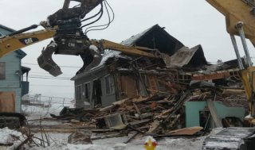
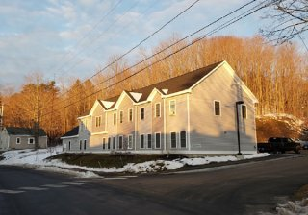
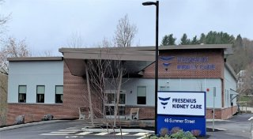
TW Dick Site – Assistance through KVCOG’s RLF
Former industrial mill site
  Petroleum, ACM, VOCs, PAHs, lead
2013 City Assessment funds
  Identified COCs/AOCs
Reuse envisioning meetings partnering with local residents, City, EPA, Maine DEP
Several funding sources:
  2016 City Cleanup grant ($200K)
  KVCOG RLF ($100K)
  DECD RLF ($234K)
Cleanup completed in 2020
Redeveloped into new medical facility and housing

Slide 9
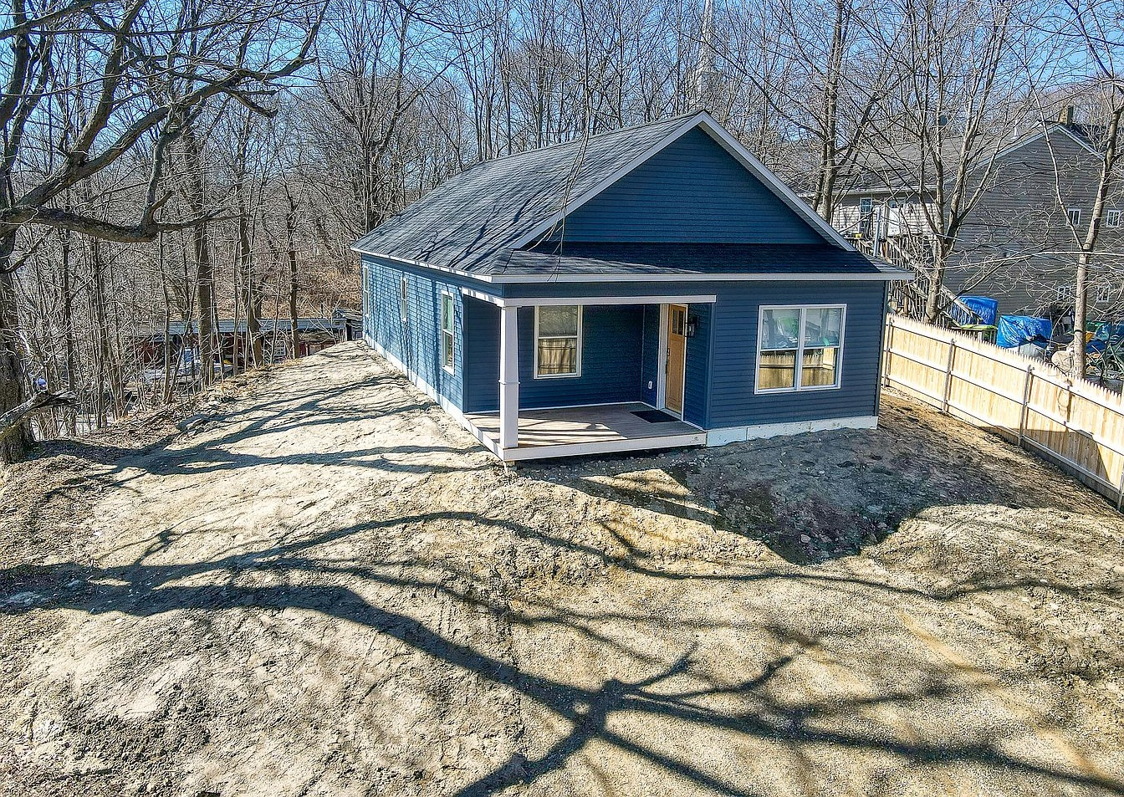
28 Spring St – Assistance through KVCOG’s RLF
Early 1900s residential structure; vacant in 2015
Asbestos and lead-based paint
KVCOG RLF ($123K)
Cleanup included:
  Full hazardous building materials abatement
  Excavation and disposal of impacted soils
  Structure demolition
Cleanup completed in 2020
Now a newly-constructed contemporary ranch residential structure

Slide 10

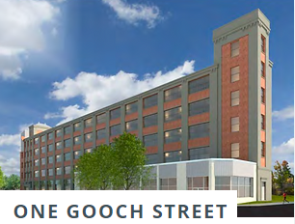
Investment in Gardiner
  Network of Maine Developers
  Could one be right for Gardiner?
Summit Ridge Energy (SRE)
  River Road Solar Project
  Highland Avenue Solar Project
Notes:
Hi Joel-
These haven’t been big projects for us so far.
In March 2022, Michael Ross prepared a short document of estimated costs for landscaping O&M for the Gardiner Solar project. The design, permitting, and landscaping plan were done by others, but SRE requested this cost estimate from TRC.
For the ConEd Gardiner Solar project (acquired by SRE), we did a MDEP Condition Compliance application documenting that SRE has financial assurance to decommission the project. That was in ~April 2022. We did the same for the Revision Energy Gardiner solar project (acquired by SRE). That work was done in ~March 2022.
We submitted a proposal to SRE in Feb 2022 for state and local permitting for a new site in Gardiner, but they have not authorized us to do work on it yet. They are having land access issues so it may not move forward.
Thanks.
Mark B

Slide 11




Leveraging Additional Resources
Track record of finding synergies through multiple funding sources
  City of Gardiner (new $500K assessment grant)
  KVCOG (RLF grants / future assessment grants)
  DEP/DECD Brownfields assessment and cleanup
  EPA site-specific cleanup grants
  Other State and local funding programs
The goal is Redevelopment!
Notes:
The best Brownfields projects involve assessment, cleanup planning, and remediation leading to redevelopment which takes several funding sources working together

Slide 12



Why TRC
Focus on Gardiner
Cost-Effective Solutions
Community Investment
Collaboration with Stakeholders
Extensive Experience
Value-Added Services
Developer Relationships
Leveraging Funding Sources
Maine Presence

Slide 13

Questions & Answers

Slide 14
Charlie Springer, LG, CHMM
207.274.2615 cspringer@trccompanies.com
Joel Prellwitz, LG, PG
207.274.2641 jprellwitz@trccompanies.com
Emily Wassmer, LG, PG
207.298.0785 ewassmer@trccompanies.com

