Slide 1

Proposed Sewer Rate Increase
November 1, 2023

Slide 2
Why?
Over the last several years, the City has maintained steady, minimal, sewer rate increases; which funded normal annual operating cost increases, and to plan for the WasteWater Treatment Plant Upgrades.
However, the fund balance has been depleted, leaving no room for unanticipated costs; as well as funding for the second phase of the upgrade.
There have been 4% increases in the last 5 fiscal years
It required half of those increases (10%) to pay for the added $133K annual debt on Phase I of the Plant Upgrade
It will require an additional 5% increase if we fund Phase II of the Plant Upgrade

Slide 3
Where we thought we would be…

Slide 4
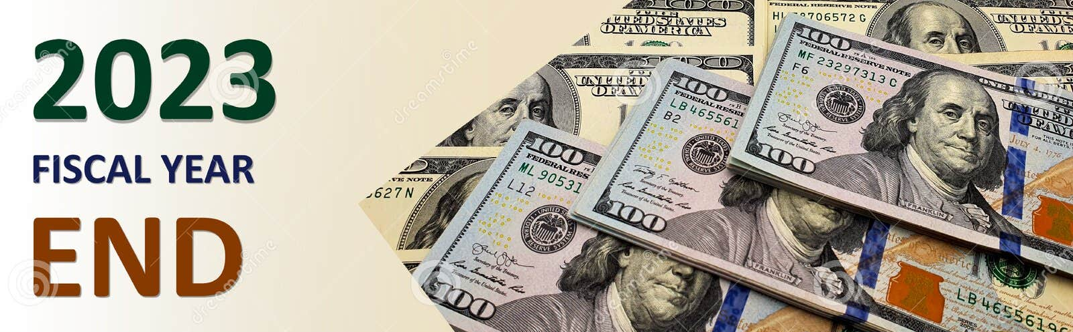
Where we are:
FY23 added expenses and less revenue resulted in the use of $300K in Fund Balance leaving a balance of $74K.
$140,000
$90,000
$70,000
Electricity, chemical price surge, and major increase in sludge disposal
South Gardiner manhole replacement, manhole adjustments, and several residential sewer issues
Less Revenue

Slide 5
Proposed Increase
30% Increase (minimum only)
Adds $200K/Year
Things to Consider
Increase to Wages & Benefits
Anticipated increase in Chemical usage
Potential for an added $75K in debt for Phase II Plant Upgrade
The Fund Balance should be built up
  Annual $2M budget - recommended fund balance of 15% ($300K)
What this means to the user:
Quarterly minimum $143.11
Annual minimum cost $572.42
    adds $33.02/quarter
    adds $143.11/year
** Approved by WasteWater Advisory Committee on 9/27/23 **

Slide 6
How do our rates compare?
Our current minimum rate puts Gardiner as the lowest rate.
Increasing by 30% will put us in the middle and only .20/quarter less than the Greater Augusta Utility District.

Slide 7

Next Steps
Nov. 15
    Public Hearing on Proposed Rate Increase
    Discussion on Phase II WW Plant Upgrades
    Council Vote on Proposed Rate Increase
Dec. 6
    Council Vote on Phase II WW Plant Upgrades
Questions or comments can be directed to Doug Clark, WasteWater Director via email: dclark@gardinermaine.com or by calling 582-1351

